Slide 1
UR Involved – Scrum Report Out
Course: ENSE 281 – Winter 2026
Instructor: Tim Maciag
Members: Robert Calinescu, Harleen Kaur, Abraham Omoregie, Peyton Bowen, Luka Dundjerovic
Notes:
As a quick recap from our project pitch, UR Involved is a centralized platform that allows students to discover clubs, request membership, and propose new clubs at the University of Regina. Today we’ll walk through our project planning and system design, and gather feedback on our prototype.

Slide 2
Who does UR Involved impact?
Project Sponsor: Dr. Maciag
Benefactors: -University of Regina -U of R Club Organizers -U of R Student Body

Slide 3
Project Roles
Member
Role
Robert | Project Lead / Database
Abraham | Frontend / UI / UX
Harleen | Frontend / UI / UX
Peyton | Backend Developer
Luka | Backend Developer

Slide 4
Requirements Overview
User Accounts
Register/Login with email and password
Secure session management
Default student role
Club Discovery
Browse clubs on homepage
Search and filter clubs
View detailed club pages with information and events
Club Interaction
Request to join clubs
View membership request status
View club events

Slide 5
Requirements Overview
Club Creation & Administration
Submit club proposals
Admin approve/reject clubs
Approved clubs added to directory
Input Validation
Required field validation
Clear user error messages
Access control for protected features
Notes:
Two key workflows drive the system: the membership request workflow and the club creation approval workflow

Slide 6
System Architecture & Project Scope
Model-View-Controller (MVC) Architecture
Model: MongoDB + Mongoose
View: HTML, CSS, Bootstrap, JavaScript, EJS
Controller: Node.js + Express.js
Authentication: Passport.js
Core System Features
Centralized club directory
Club detail pages with events
Search and Filtering
User authentication system
Join club request workflow
Club creation proposal workflow
Role-based Access Control
Project Boundaries
no U of R system integration
no payment processing
no mobile application
no real-time social media integration
no production deployment

Slide 7
User Roles
Our plan is to have 4 types of users, in order of impact on the site:
-(A)Administrators: Executive control over site.
-(3)Club Organizers: Can manage respective club.
-(2)Students: Can join clubs.
-(1)Guests: Can only view information.
In addition, users have access to anything that
below users can do.
A
3
2
1
The capabilities of role 3 encompass itself, along with roles of lower number.

Slide 8
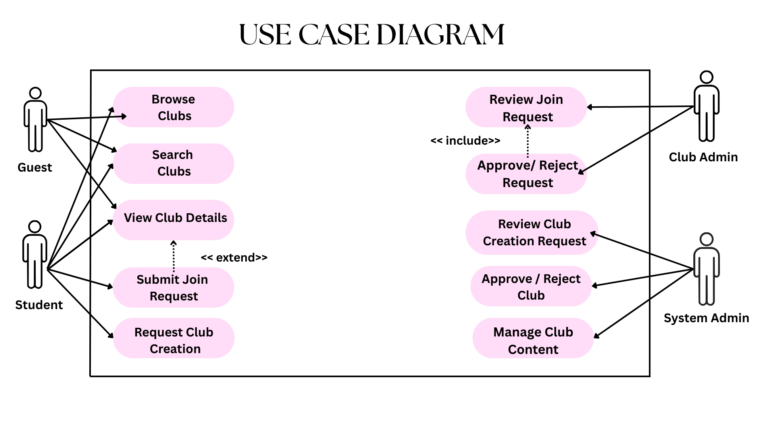
Notes:
IT SHOWS HOW DIFFERENT USERS PERFORM DIFFERENT ACTIONS IN THE SYSTEM

Slide 9
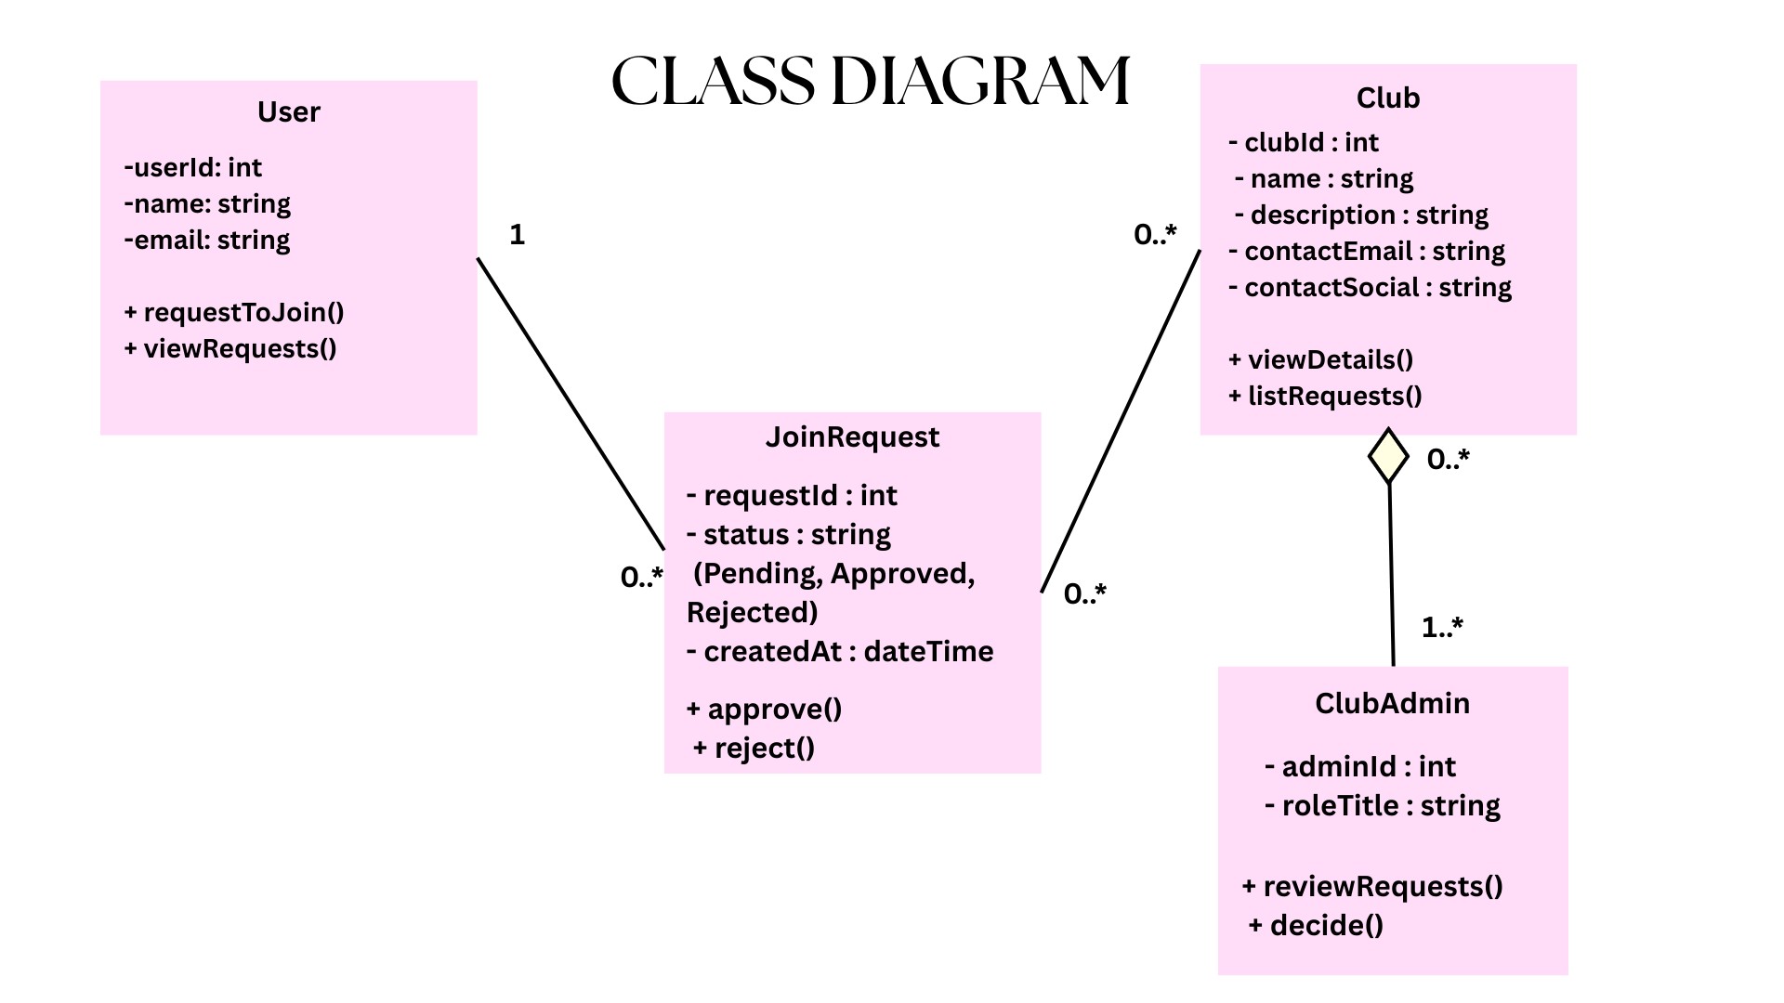
Notes:
IT SHOWS THE STRUCTURE OF THE SYSTEM AND HOW THE SYSTEM IS ORGANIZED. THE MAIN CLASSES ARE USER, JOIN REQUEST AND CLUB ADMIN. EACH CLASSES STORES DIFFERENT INFORMATION LIKE USER DETAILS , CLUB INFORMATION. AND JOIN REQUEST STATUS. THE RELATIONSHIP SHOW HOW USERS CAN SEND JOIN REQUESTS AND HOW ADMINS MANAGE THOSE REQUESTS.

Slide 10
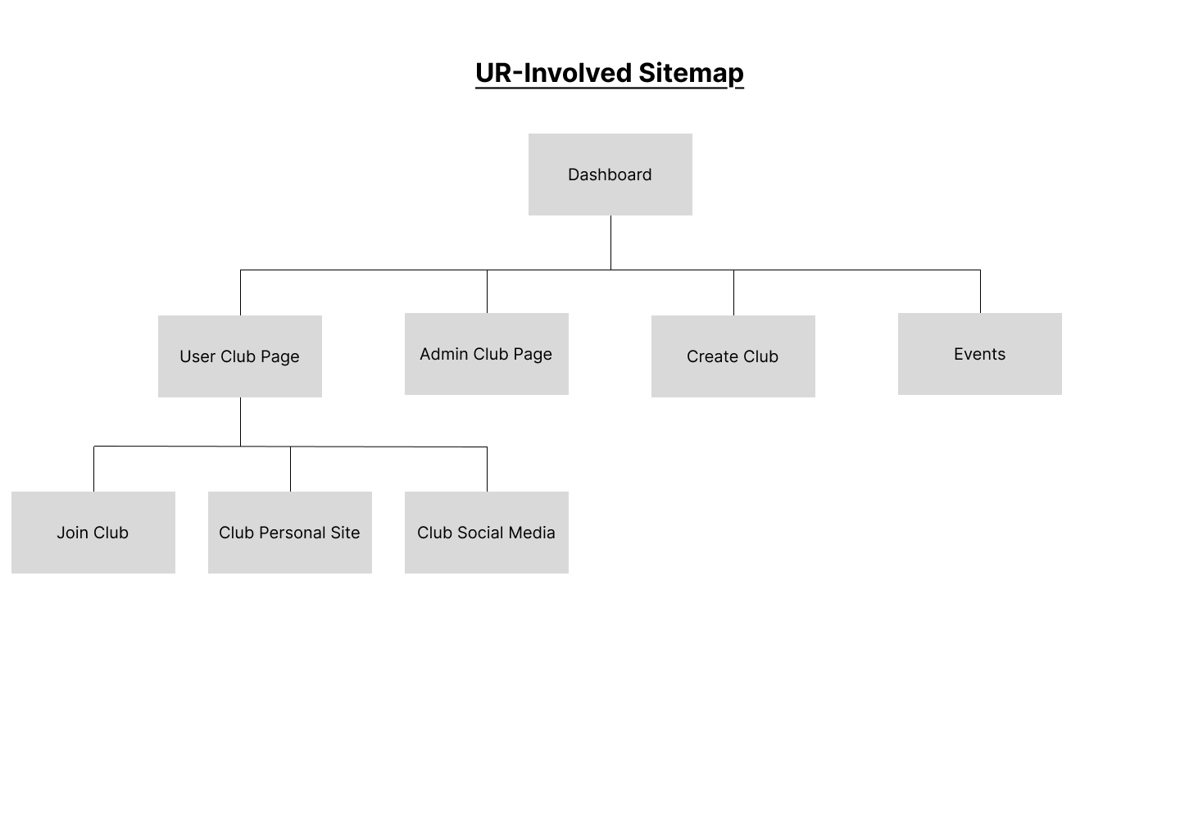
Design and Layout
Each club will have club details page. Club details page will include events, news and request to join tabs
We will look at the most important pages next
Notes:
explain content of slide, load images of relevant pages and explain them. did not include them in presentation because cannot fit in slides

Slide 11
Prototype

Slide 12
Questionnaire
Based on this club detail page, would you feel you have enough information to decide whether to join a club?
What are your opinions on the lofi prototype so far. Any recommendations?
Would you add/remove anything from the current site map?
What parts of the design did you like?
What parts of the design did you dislike?
Is there anything else we should add to the dashboard?

